Slide 2
Microsoft Web Platform
David CATUHE
Principal Program Manager
@deltakosh
Jeff BURTOFT
Senior Program Manager
@boyofgreen

Slide 3
Microsoft Edge

Slide 4
Why a new engine?

Slide 5
1995
2015
1
2
3
4
4.x
5
5.5
6
7
8
9
9
10
11
Trident

Slide 6
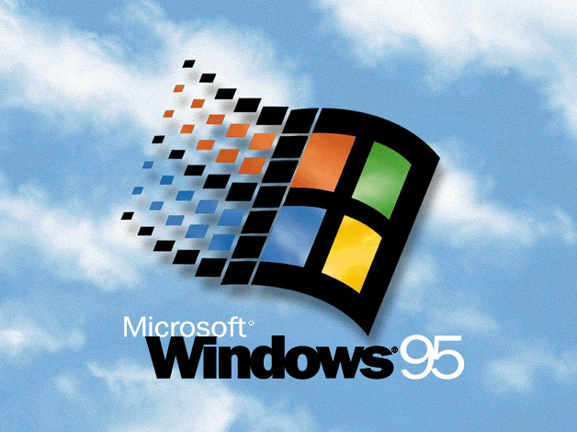


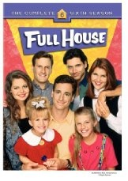
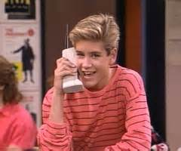
1995 was 20 years ago…

Slide 7

HTML4, ES3, CSS2
1995
1995
2015
1
2
3
4
4.x
5
5.5
6
7
8
9
9
10
11
Trident
Quirks
Strict
!DOCTYPE

Slide 8

Modern Web
HTML5, SVG, ES5, CSS3
Legacy Web
CSS2.1
HTML4, ES3, CSS2
1995
2015
1
2
3
4
4.x
5
5.5
6
7
8
9
9
10
11
Trident
IE5
Quirks
IE7
Compat View
IE8
Standards Mode
EMIE
Enterprise Mode
!DOCTYPE
x-ua-compatible
IE9
Standards Mode
IE10
Standards Mode
QME
Quirks Mode Emulation
IE11
Standards Mode

Slide 9







11
E
Always up-to-date
Update frequently
Single doc model
Always up-to-date
Update frequently
Single doc model
10
9
8
7
Q
14
12
13
34
35
Firefox
5
Chrome

Slide 10

11
E
Ever Green Engine
Update frequently
Single doc model
Always up-to-date
Update frequently
Single doc model
Ever Green Engine
Update frequently
Single doc model
10
9
8
7
Q
14
13
34
35
Firefox
5
Chrome

Slide 11
New features

Slide 12
And more…
4200+ Interoperability Fixes, Preserve-3d, Touch Events, CSS Filter Effects, DOM Clipboard Support, HTML Drag and Drop, Web Audio, CSS Position Sticky, CSS @supports, CSS Flexbox, HTML Beacon, WebDriver, IndexedDB, WebCrypto, Internation Mixed Languages Support, CSS Grid, CSS Variables, srcset, <picture> element, Web Workers Update, DOM4 Events, Font Loading, BDI, Cross-domain, HLS Manifest, Block Ellipsis, WAV, @rules, CSS Text(), CSS Border Logical, Logical Box Model, DOM Gamepad API, DOM FileSystem API, HTML <date> element, HTML <keygen> element, HTML <main> element, HTML <output> element, HTML <summary> element, HTML <detail> element, HTML <time> element, Native PDF, AppCache, SVG Hosting, Mutation Observers, HTML bidirectional, HTML Speech API, SVG animations, SVG transitions, SVG transforms, Canvas Path, Canvas Accessibility API, CSS Select Control, CSS Masking, CSS Clipping, Navigation Error Logging, CSS element(), CSS Shapes, ORTC, CSS Escape, Shared Workers, ES6 Modules, ES6 Promises, CSS Intrinsic & Extrinsic Sizing, Web Components, CSS Scoped Styles, HTTP 2.0, CSS Resize, WebGL, Canvas Blend Modes, CSS Interpolation, CSS Line Grid, CSS Line Box Contain, CSS Ruby, DOM Event Constructors, HTML <ol> Reverse, Server-Sent Events, Viewport APIs, Quota API, etc.

Slide 13
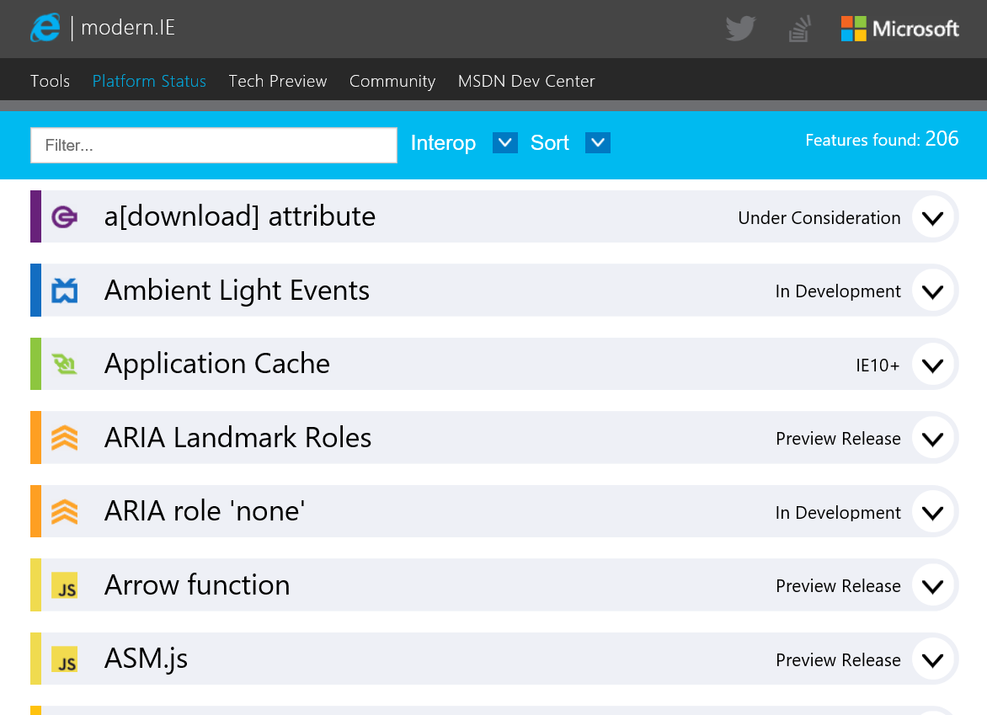
status.modern.ie

Slide 14


What’s possible today with just a browser…

Slide 15
Highly requested features…
WebAudio
Pointer events
CSS filters
ForeignObject
http/2

Slide 16
Modern web interoperability
The Web should just work for everyone (But sometimes it doesn’t)

Slide 17
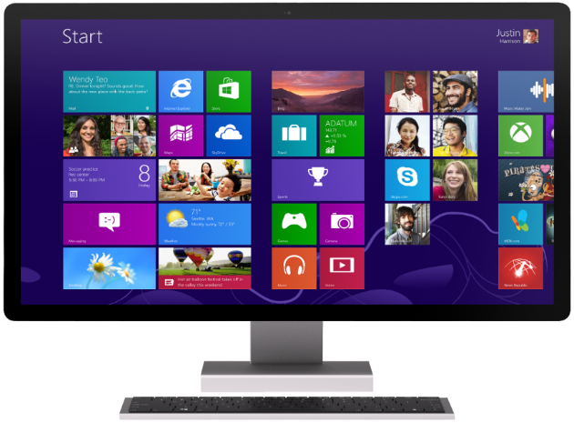
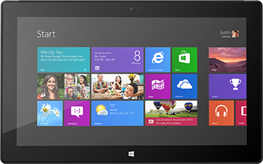
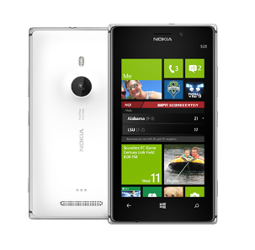
The web is on a wider variety of devices than ever
The dream: Write once, run anywhere

Slide 18
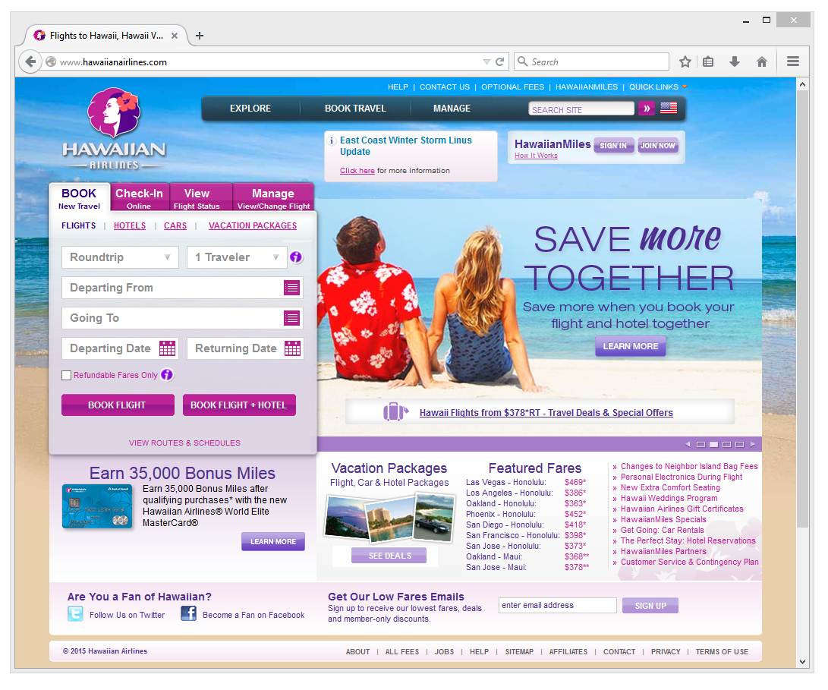
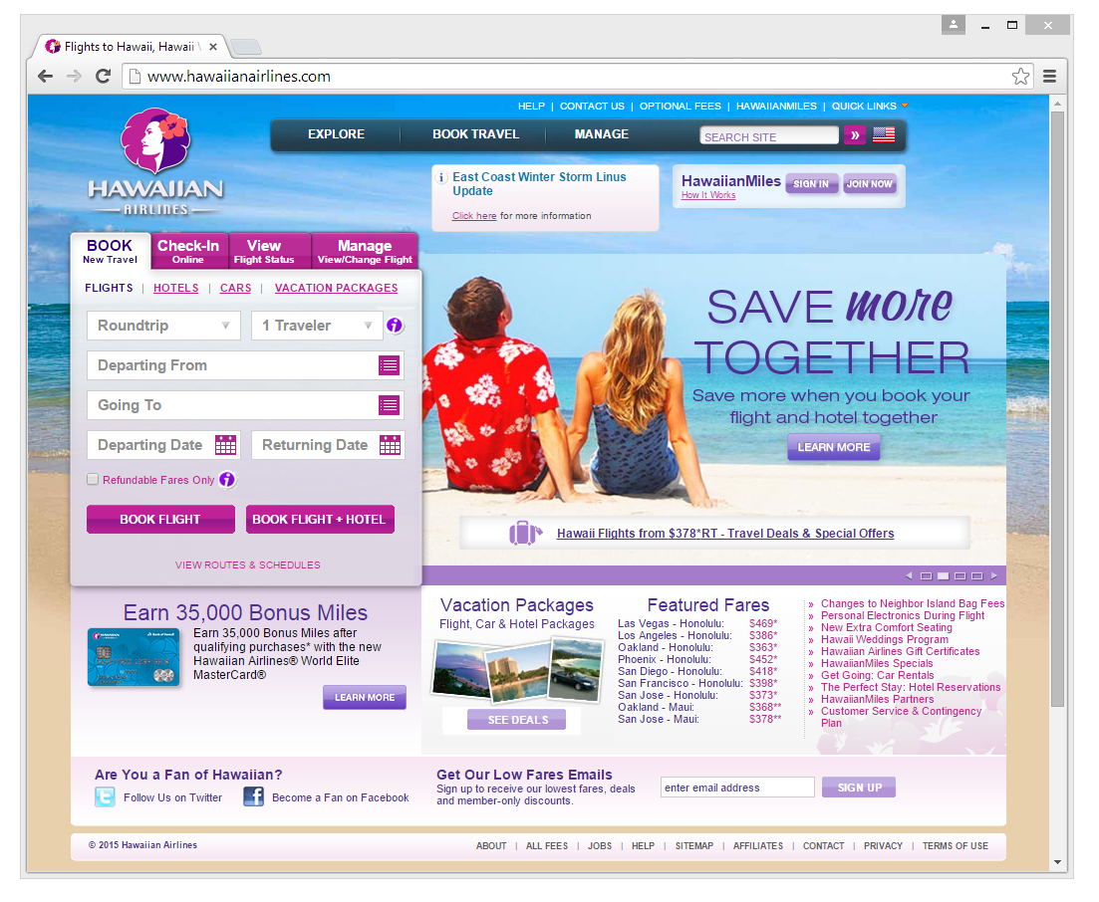
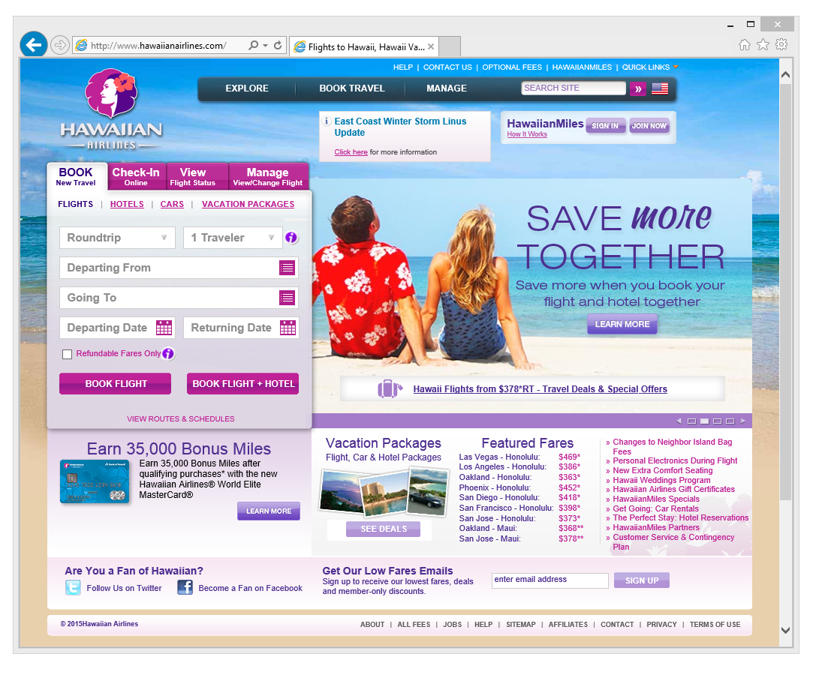

Firefox
Chrome

Slide 19



Interoperable intersection

Slide 20
Interoperable intersection

Slide 21

User-Agent Strings
Firefox
Mozilla/5.0 (Windows NT 10.0; WOW64; rv:35.0) Gecko/20100101 Firefox/35.0
Safari
Mozilla/5.0 (Macintosh; Intel Mac OS X 10_10_1) AppleWebKit/600.1.25 (KHTML, like Gecko) Version/8.0 Safari/600.1.25
Chrome
Mozilla/5.0 (Windows NT 10.0; WOW64) AppleWebKit/537.36 (KHTML, like Gecko) Chrome/40.0.2214.93 Safari/537.36
Mozilla/5.0 (Windows NT 10.0; WOW64) AppleWebKit/537.36 (KHTML, like Gecko) Chrome/39.0.2171.71 Safari/537.36 Edge/12.0

Slide 22
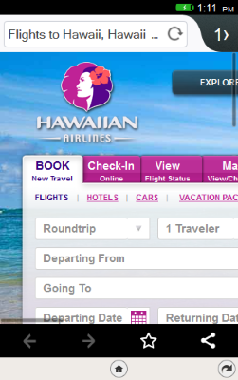
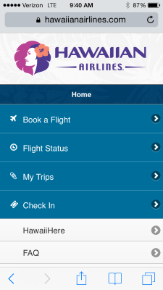


Slide 23
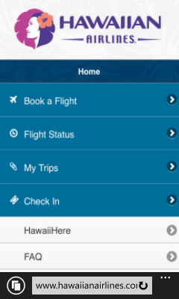

Slide 24
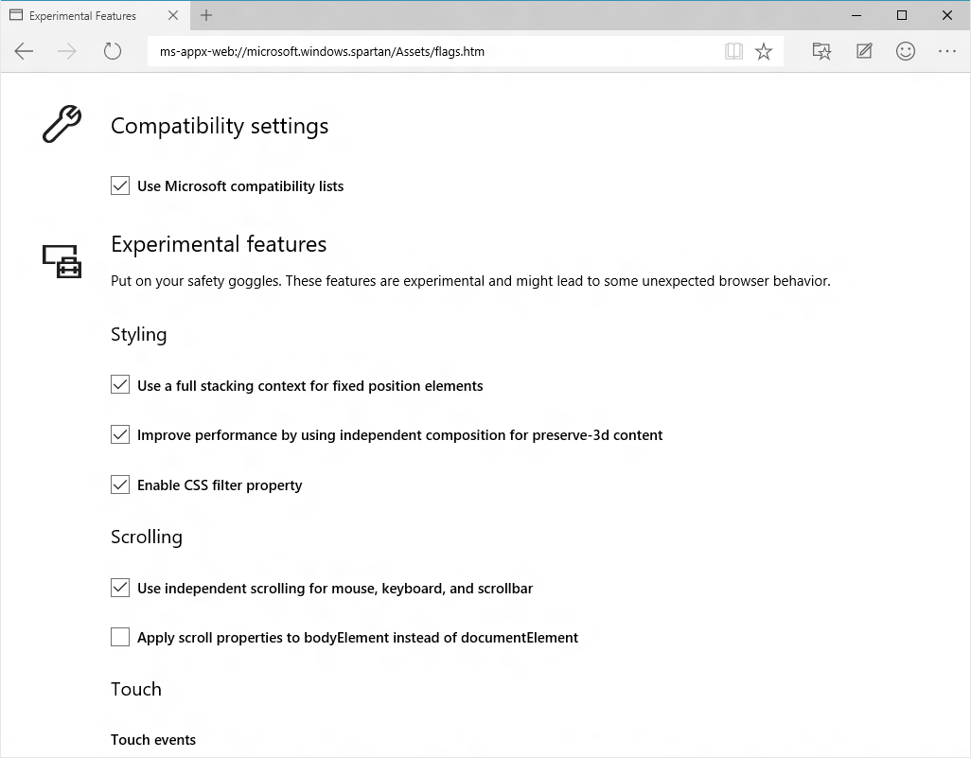
About:flags

Slide 25
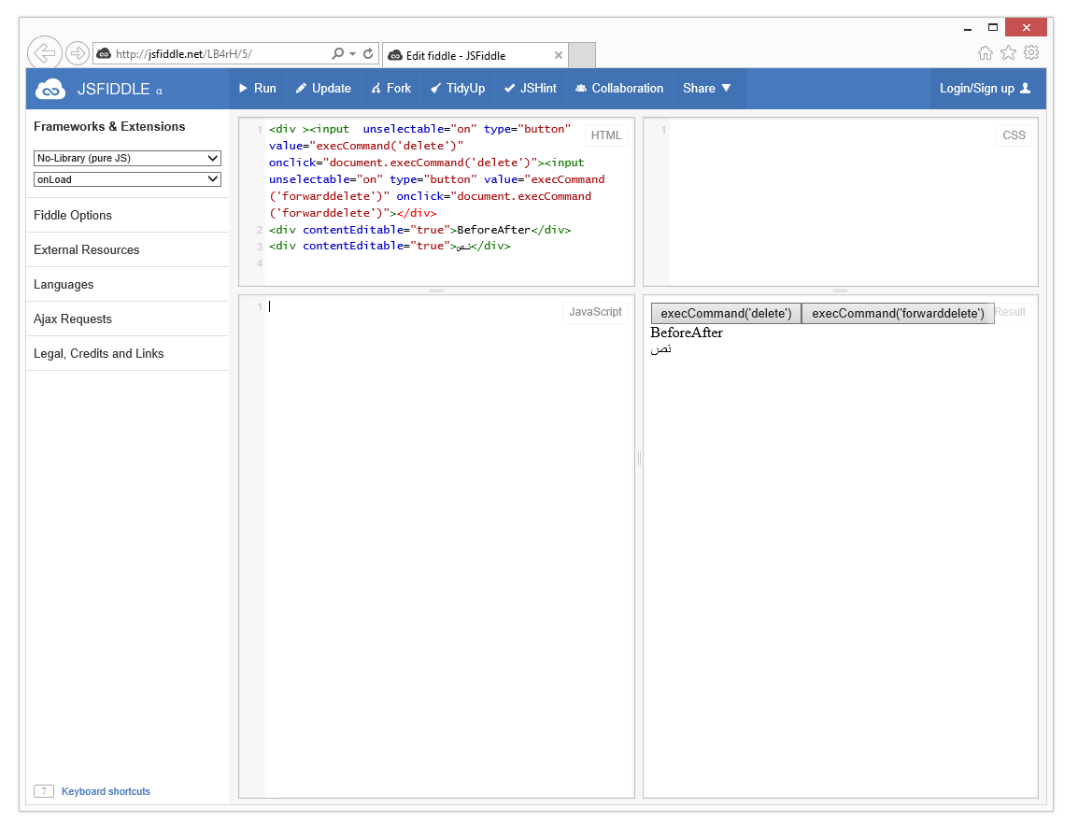
How can I make it better as a web developer?
Do feature detection
Avoid UA sniffing
Unknown browsers are probably good browsers
File bugs on browsers (with a simple reproduction)

Slide 26
Web app platform

Slide 27
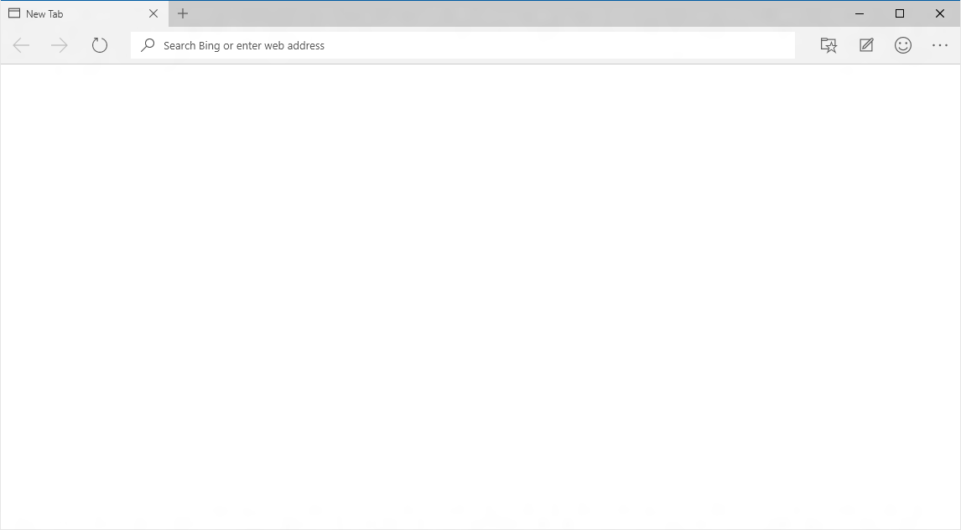
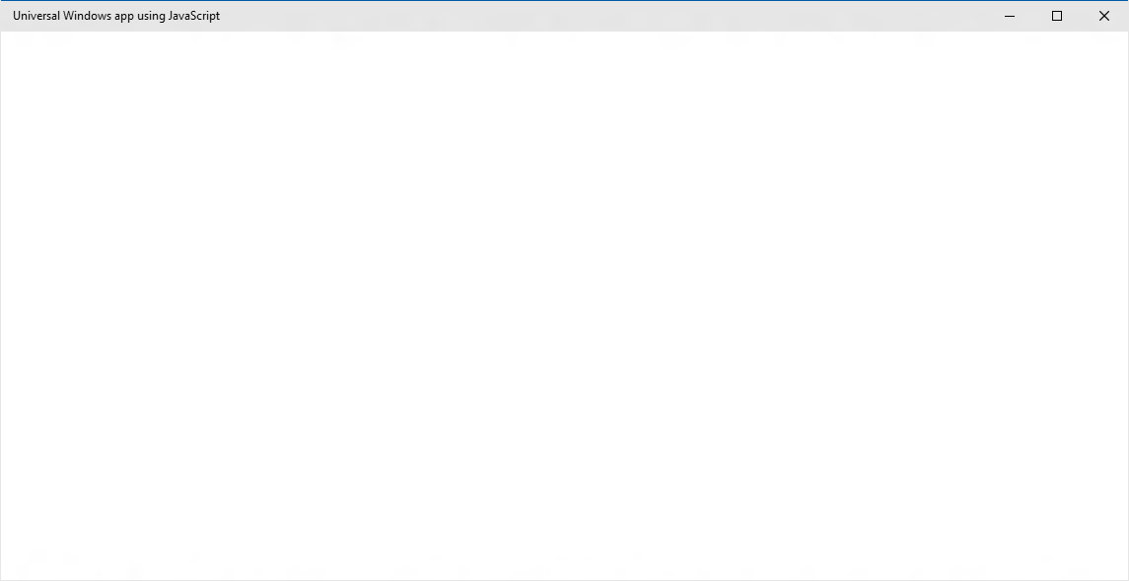
EdgeHTML.dll
Chakra
Packaged content
Offline first
Hosted content
Always up-to-date

Slide 28
Default CSP is the security model for packaged apps
Standards Based Security Model
Default policy applied to local content
script-src ms-appx: data: 'unsafe-eval'; style-src ms-appx: data: 'unsafe-inline' object-src 'none'; font-src ms-appx: data:;
Custom policy specification available
Load local content through ms-appx-web:///
Specify policy in html page head with a metatag
<meta http-equiv="Content-Security-Policy" content="script-src ms-appx: data:”>

Slide 29
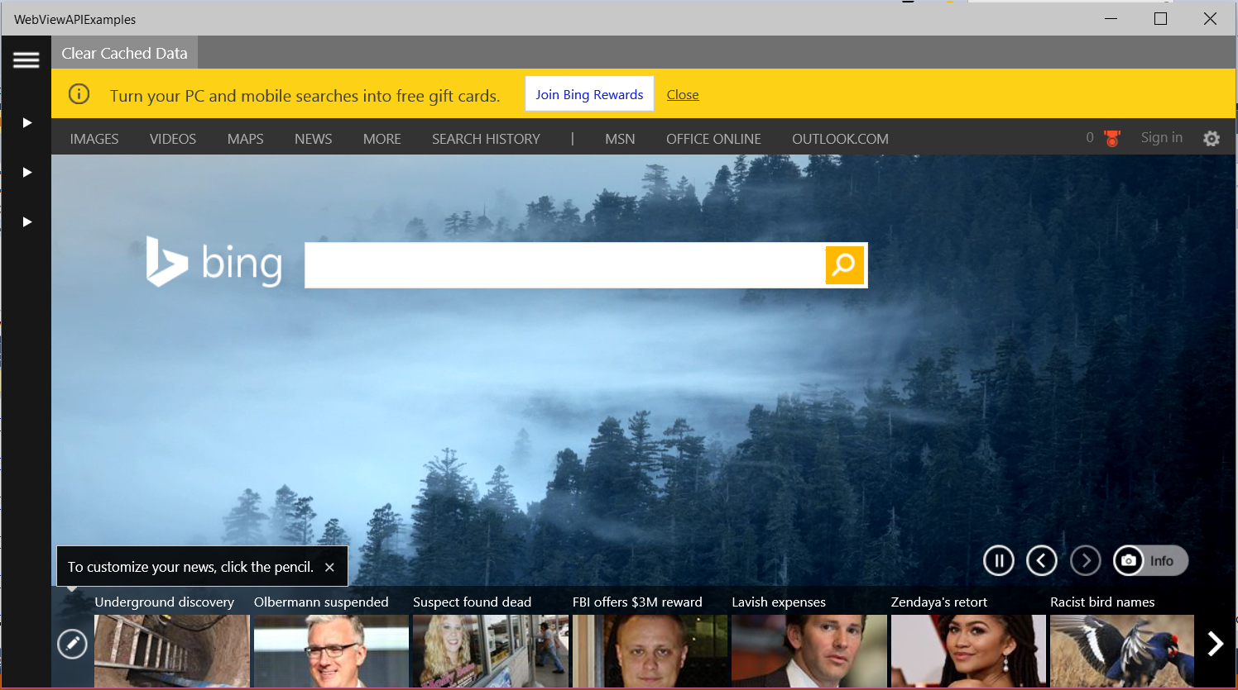
WebView Control
Uses the always current Edge rendering engine
Great for HTML5 and the modern web
Improved app performance and responsiveness
WebView is now off the UI thread
Rich API Set
Aimed towards a powerful in App Browser for UAP Apps
Improved App to WebView communication
More control over behavior of content

Slide 30
WebView Control – New API
AddWebAllowedObject API
Enables smooth interaction between the application and the WebView Control
Developers are able to directly inject a native C#/C++ object into the script engine
// Injecting the Object:
var notification= new Notification.ToastClass();
webview.addWebAllowedObject(“UniversalWindowsAPIs ", notification);
// Calling from WebView:
var notification= window.notification;
if (notification) {
notification.toastMessage('Hello World', 0);
}

Slide 31


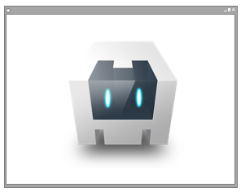

Cordova
Packaged
Hosted
Embedded
Native Cordova app with the code stored locally
Native Cordova app with the code stored on a server
Cordova apps housed within a broader native application

Slide 32
Hosted Web Apps

Slide 33
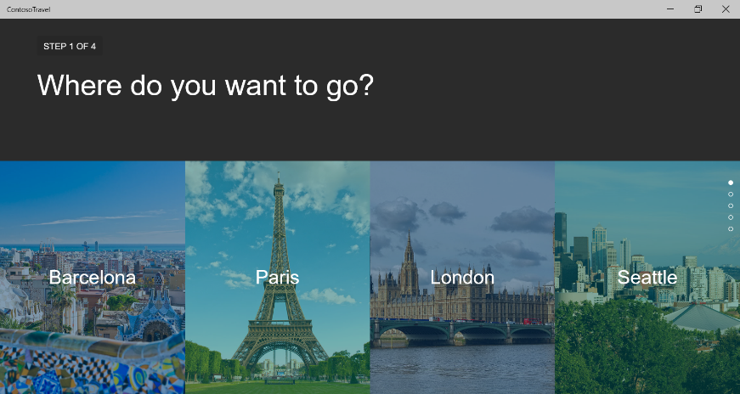
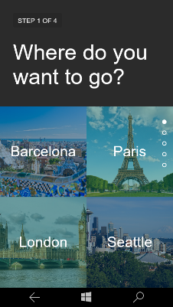

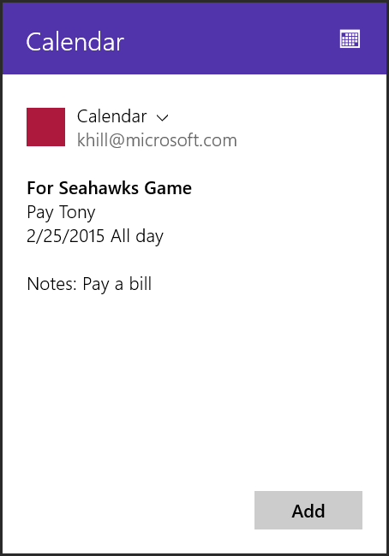
Hosted Web Apps
Publish your website to the Windows store
Call Windows Universal APIs from JS on your website
Mix in native code, accessible from the site
Integrate with Cortana
Feature Detect Windows
Native APIs
Trip to Barcelona
3/25/2015 All Day
Native APIs
Notes: Return to work

Slide 34
Hosted App Demo
Shiftr Connections

Slide 35
Allow Access to Windows APIs
AppxManifest URI Allow List (ApplicationContentUriRules)
WindowsRuntimeAccess=
"all" Match="https://*.websites.net/"
"allowForWebOnly" Match=https://*.website.net/
Developers can control the Universal APIs they want to expose
"none" Match="http://ads.website.net/"
Default is no access

Slide 36
Cortana Integration
Add a Voice Command Definition file on your server
Add a meta element tag in your HTML
Handle the Cortana activation in your JavaScript
<meta name="msapplication-cortanavcd" content="http://mysite.com/vcd.xml"/>" content="http://flightarcade.azurewebsites.net/vcd/vcd.xml"/>
// Add an event listener for the activation event
if (Windows.UI.WebUI.WebUIApplication.addEventListener(“activated”, function (args)) {
// Handle the Voice Command activation event
var activation = Windows.ApplicationModel.Activation;
if (args.kind === activation.ActivationKind.voiceCommand) {
// Extract the result from the speech recognition from the event arguments
var speechRecognitionResult = args.result;
// Get the recognized command, defined in the VCD file
var command = speechRecognitionResult.rulePath[0];
// Get the full string of text that was spoken
var textSpoken = speechRecognitionResult.text;
}
});

Slide 37
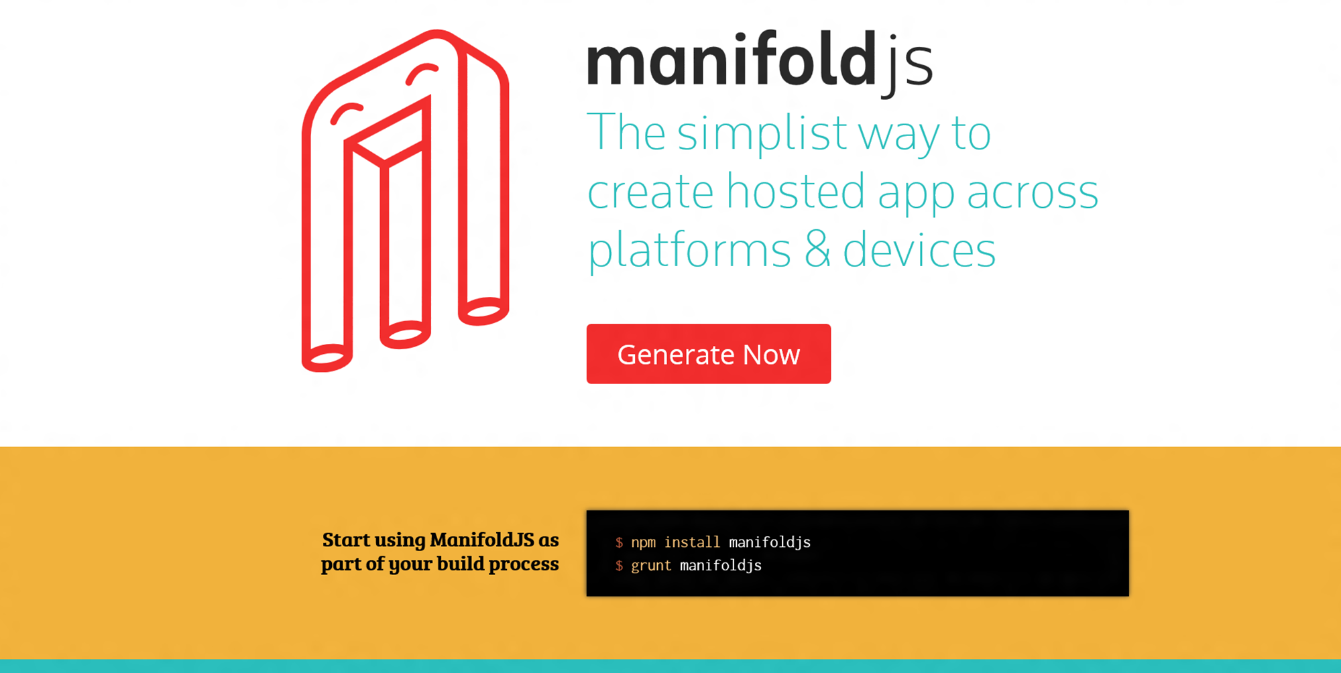

www.manifoldjs.com

Slide 38

Making Cross browser development a little bit easier

Slide 39

www.manifoldjs.com

Slide 40
Manifoldjs demo

Slide 41
Going further….
More on Microsoft Edge:
http://dev.modern.ie
Open source tools:
www.manifoldjs.com
www.vorlonjs.com

Slide 42
Thank you! Questions ?

